Slide 1
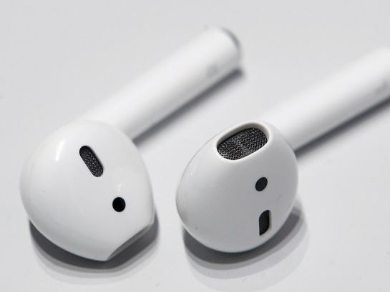
nat5 Design & Manufacture
Research

Slide 2
Learning intentions & success criteria
Learning Intentions
Developing my understanding of research methodology.
Success Criteria
Understand the different ways to conduct design research.
Conduct research online, in books and magazines, annotate these and compare existing products.

Slide 3
research
Research is an important element when designing as it provides the information you need to design a successful product.
Research helps designers to make meaningful design decisions.
Although research is important at the start of a design project, it should continue all the way through..

Slide 4
Research TECHNIQUES
When completing research, the following methods can be used to gather information:
Product Comparisons
Consumer Reviews
User Trials
Survey
Product Testing
Situation Analysis
Measuring and Recording
Using the Internet
We will explore these in more detail later.

Slide 5
Research PLAN
Design Factors | Research Method | Justification
Ergonomics | Measuring and recording | I need to find out: What is the size of the lady’s hand/ At what height should the box be mounted on the wall?
Function | Using the internet to research facts | I need to find out: What jewellery will be stored in the box? How will I make my design easy to open and close?
Aesthetics | Comparison to other products | I need to find out: What styles, shapes and colours are currently available on the market?
A research plan will help you organize your work and ensure that you have selected the most relevant design factors.
Following completion of the research plan, the designer is ready to begin their research. The questions posed will help the designer justify the design factors chosen.
EXAMPLE: opposite is an example of a research plan for a wall-mounted jewellery box for a fashionable woman in her 30s.

Slide 6
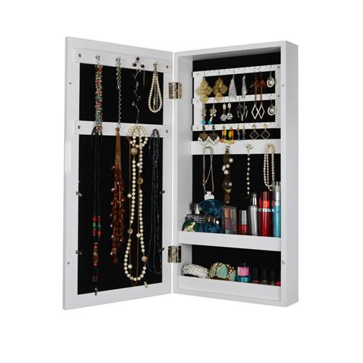
Research PLAN
Following the completion of the research plan, the designer is ready to begin their research.
The questions posed or statements drawn up will help the designer to justify the design factors that have chosen, providing reassurance to the team and the client that they are on the right track.
In the jewellery box example, for “function,” the following statements might be used:
FUNCTION:
Jewellery types
Jewellery volume
Jewellery sizes
Hinges and catches
Storage features

Slide 7
Methods for presenting research
When doing research, you will gather a range of evidence. When presenting your research findings, a clear layout is important. This helps to make your work easy to understand and use when you are designing.
Your research evidence may include:
A collection of images
Written information
Annotated sketches
Labelled diagrams
Tables of information
A series of photographs
Video evidence

Slide 8
Methods for presenting research
Your research should provide the answers to the questions or statements you compiled for your research plan. Your can present your answers by annotating tables, images and diagrams, or by highlighting text. You may also wish to write a summary of the most relevant findings using bullet points. Some key phrases to use are:
This would be the best (material, finish, etc) to use because…
Analysing all the information reveals…
This identifies the most suitable…
The range of information here can be applied to…
These details would be appropriate for…
Although this is useful, it cannot be applied to the design because…

Slide 9
Examples of research
You only need to find the information you require in your research
Avoid making assumptions, especially if you feel you know something about, for example, the brief or the market.
Check through research!

Slide 10
Examples of research
The following slides will show 2 examples of a pupil’s research.
Remember that research should be about finding relevant facts.
What are your opinions of their research?

Slide 14
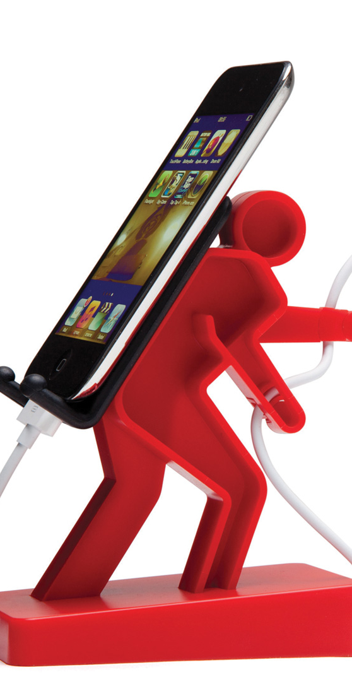
Task 1
Research existing phone holders/stands online
Save images or sketch these on an A3 Landscape page
Annotate your research and consider design factors
Include dimensions and other relevant information you think is important
Your questionnaire/survey and results can be used to backup your decisions on colour, size, theme etc.

